Slide 1

How
I
Learned
to
Stop
Worrying
and
Love
the
Zygohistomorphic Prepromorphism
Ivan Towlson
Microsoft
http://www.heyuguys.com/top-10-best-worst-days-in-cinema/peter-sellers-as-dr-strangelove/

Slide 2
How
I
Learned
to
Stop
Worrying
and
Love
SharePoint 2016
Ivan Towlson
Microsoft
http://www.heyuguys.com/top-10-best-worst-days-in-cinema/peter-sellers-as-dr-strangelove/

Slide 3
How
I
Learned
to
Stop
Worrying
and
Love
SharePoint 2016
in the Enterprise Environment
Ivan Towlson
Microsoft
http://www.heyuguys.com/top-10-best-worst-days-in-cinema/peter-sellers-as-dr-strangelove/

Slide 4
How
I
Learned
to
Stop
Worrying
and
Deploy
SharePoint 2016
in the Enterprise Environment
Ivan Towlson
Microsoft
http://www.heyuguys.com/top-10-best-worst-days-in-cinema/peter-sellers-as-dr-strangelove/

Slide 5
How
I
Learned
to
Use
Visual Basic® Scripting Edition
to
Deploy
SharePoint 2016
in the Enterprise Environment
Ivan Towlson
Microsoft
http://www.heyuguys.com/top-10-best-worst-days-in-cinema/peter-sellers-as-dr-strangelove/

Slide 6
Accelerate
Your
Readiness
by
Using
Visual Basic® Scripting Edition
to
Deploy
SharePoint 2016
in the Enterprise Environment
Ivan Towlson
Microsoft
http://www.heyuguys.com/top-10-best-worst-days-in-cinema/peter-sellers-as-dr-strangelove/

Slide 7
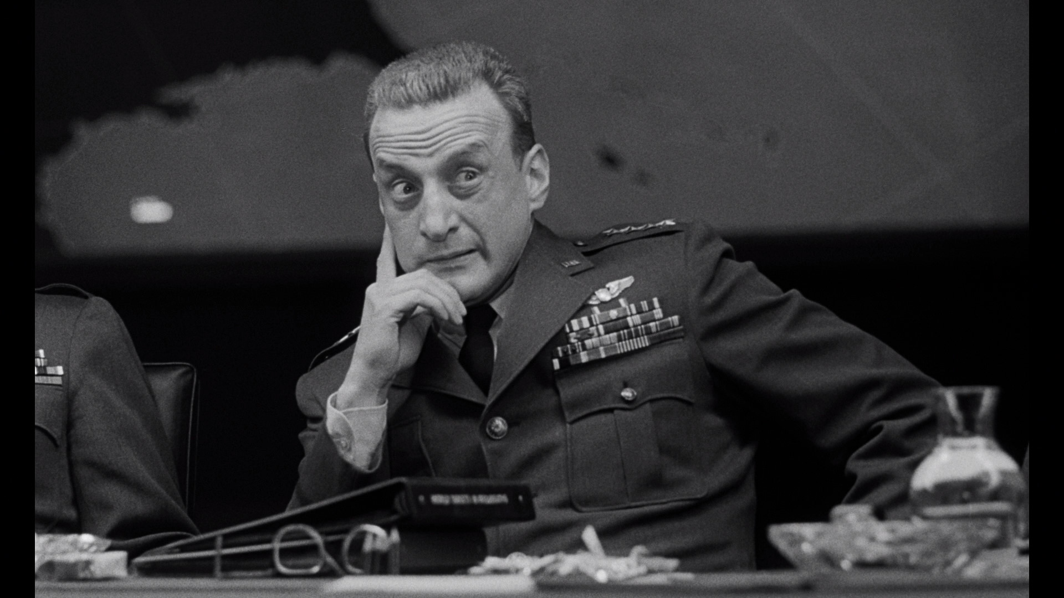
Accelerate
Your
Readiness
by
Using
Visual Basic® Scripting Edition
to
Deploy
SharePoint 2016
in the Enterprise Environment
Ivan Towlson
Microsoft
https://copiouscope.wordpress.com/2013/02/17/dr-strangelove-or-how-i-learned-to-use-a-predictable-title/, the irony of which is not lost on me

Slide 8
functional programmer (noun)
One who names variables x,
names functions f,
and names code patterns zygohistomorphic prepromorphism
@jamesiry

Slide 9
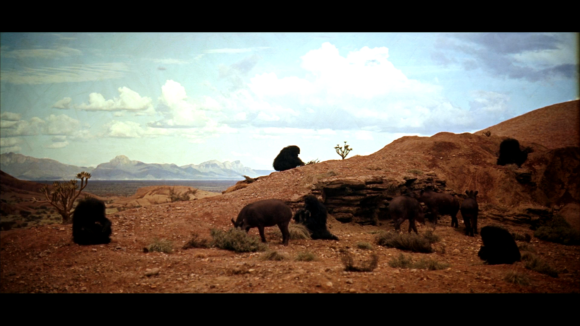
The dawn of history
https://stillsfrmfilms.wordpress.com/2012/07/19/2001-a-space-odyssey/

Slide 10
The dawn of history… 1957
https://stillsfrmfilms.wordpress.com/2012/07/19/2001-a-space-odyssey/

Slide 11
The dawn of history… 1957 1964
10 DIM NEWPRICES(LEN(PRICES))
20 I = 1
30 NEWPRICES(I) = 2 * PRICES(I)
40 I = I + 1
50 IF I <= LEN(PRICES) GOTO 30
60 PRINT "PROFIT!!!"
Disclaimer: Actual history may not have started with BASIC

Slide 12
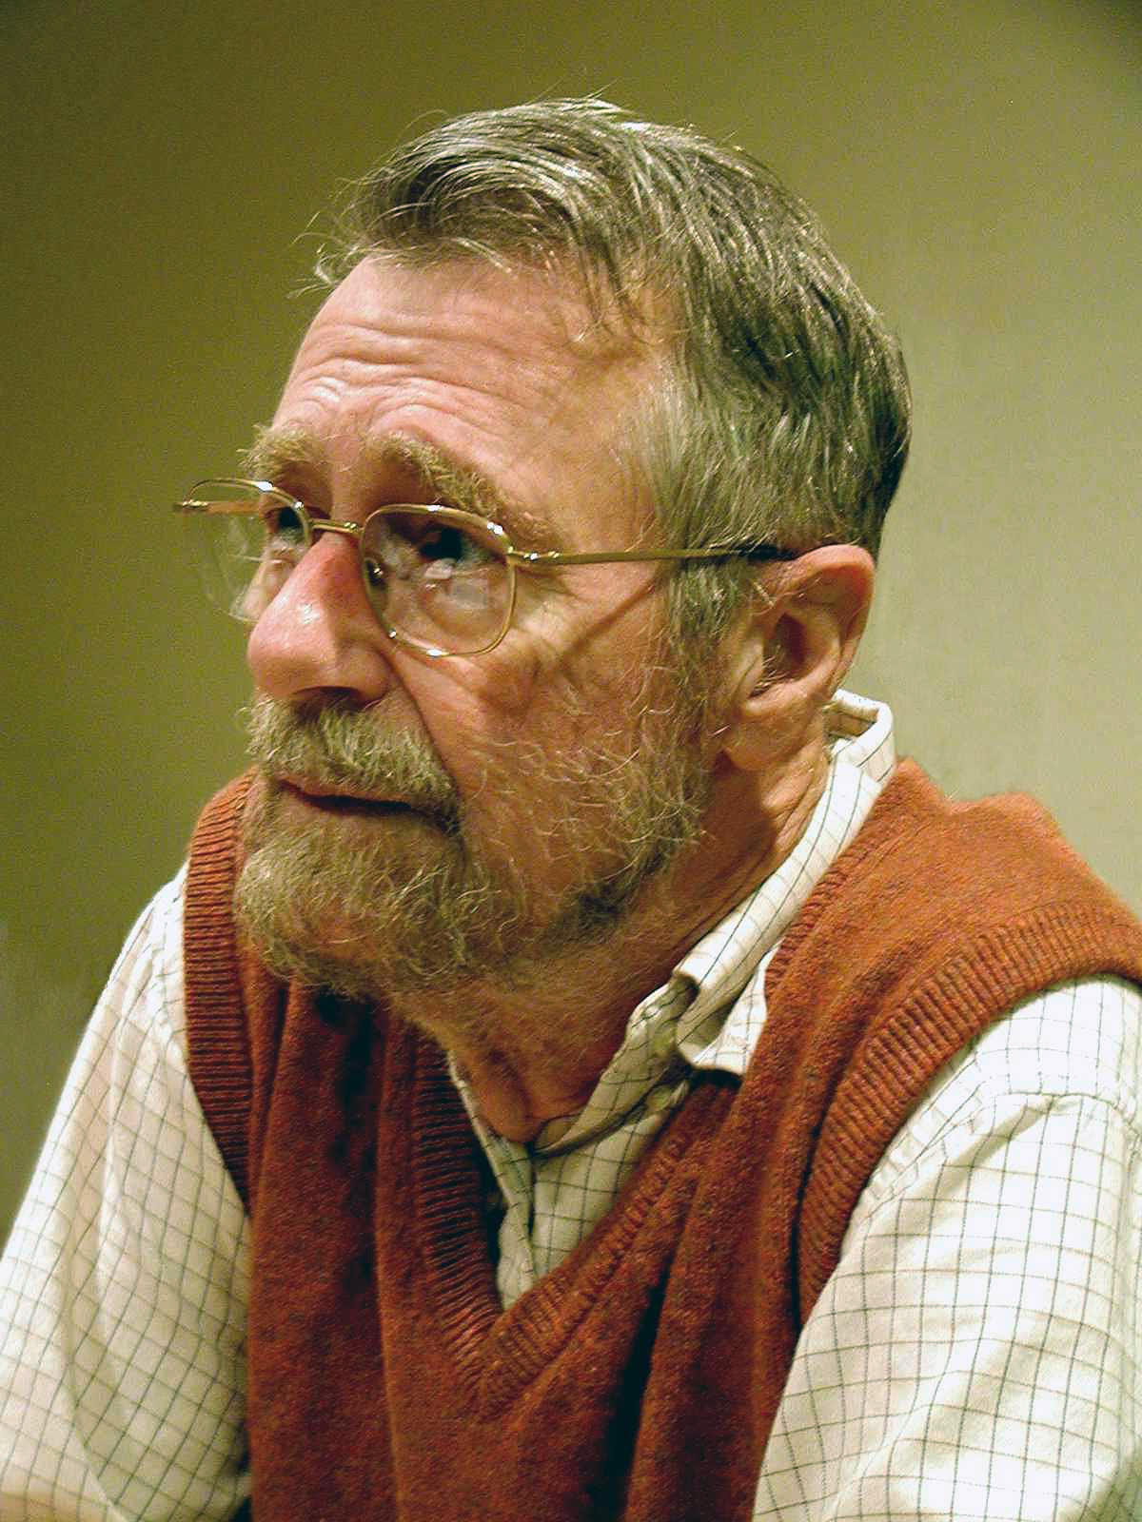
A new hope
By Hamilton Richards - manuscripts of Edsger W. Dijkstra, University Texas at Austin. (Mirrored), CC BY-SA 3.0, https://commons.wikimedia.org/w/index.php?curid=46866934

Slide 13
A new hope
int* newPrices = new int[numPrices];
for (int i = 0; i < numPrices; ++i)
newPrices[i] = 2 * prices[i];

Slide 14
A new hope
List<int> newPrices = new List<int>();
foreach (int price in prices)
newPrices.Add(2 * price);

Slide 15
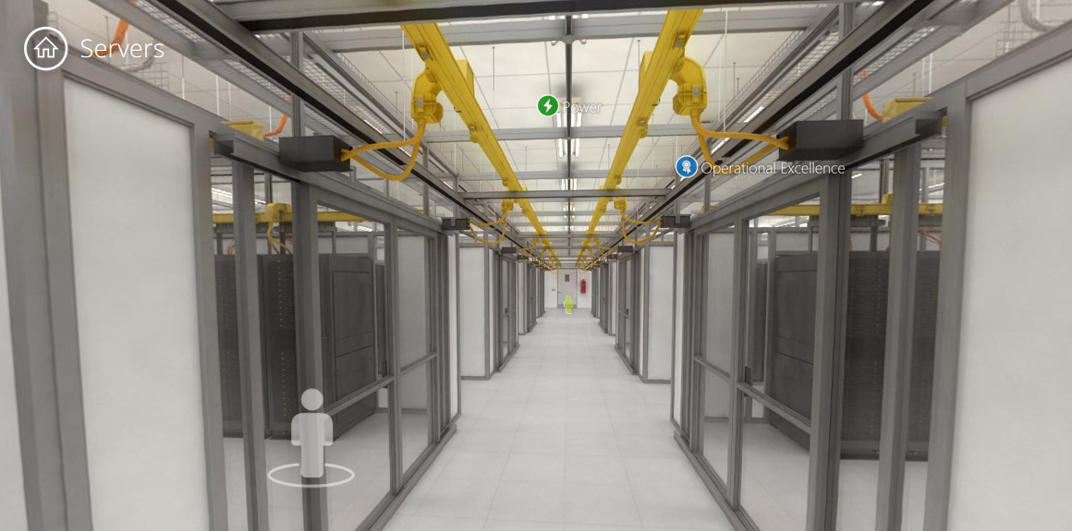
The present day
https://www.microsoft.com/en-us/server-cloud/ms.datacenter.tour/datacenter/servers.html

Slide 16
The present day… 1958
(mapcar (lambda (x) (* x 2)) prices)

Slide 17
The present day
prices.Select(x => x * 2);

Slide 18
The present day
prices |> List.map ((*) 2);

Slide 19
Abstractions
foreach (var p in prices)
newPrices.Add(p * 2);
prices.Select(p => p * 2);

Slide 20
Abstractions
foreach (var c in customers)
if (c.Balance < 0)
deadbeats.Add(c);
customers.Where(c => c.Balance < 0);

Slide 21
Abstractions
foreach (var o in pendingOrders)
outstanding += o.TotalValue;
pendingOrders.Sum(o => o.TotalValue);

Slide 22
Abstractions
foreach (var y in years)
totalInflation *= y.AnnualInflation;
years.Product(y => y.AnnualInflation);

Slide 23
Abstractions
foreach (var s in scores)
best = Max(s, best);
scores.Max();

Slide 24
Abstractions
foreach (var w in words)
endlessBabble += w + " ";
words.CursesSumDoesntWork();

Slide 25
Abstractions… of abstractions
pendingOrders.Sum(o => o.TotalValue);
pendingOrders.Aggregate((acc, o) =>
acc + o.TotalValue);

Slide 26
Abstractions… of abstractions
years.Product(y => y.AnnualInflation);
years.Aggregate((acc, y) =>
acc * y.AnnualInflation);

Slide 27
Abstractions… of abstractions
scores.Max();
scores.Aggregate((acc, s) =>
Max(acc, s));

Slide 28
Abstractions… of abstractions
foreach (var w in words)
endlessBabble += w + " ";
words.Aggregate((acc, w) =>
acc + w + " ");

Slide 29
Abstractions… of abstractions
foreach (var x in xs)
result = f(result, x);
xs.Aggregate((acc, w) =>
f(acc, w));

Slide 30
Abstractions… of abstractions
foreach (var x in xs)
result = f(result, x);
xs.Aggregate(f);

Slide 31
Sum | Product | Max | Min | …

Slide 32
Aggregate

Slide 33
fold

Slide 34

Image: Anthony Cramp, http://www.flickr.com/photos/anthonycramp/4428561177/
Licensed under the Creative Commons Attribution 2.0 Generic license

Slide 35
fold
fold : (accumulator_fn, seed, seq) -> val

Slide 36
unfold
unfold : (seed, generator_fn) -> seq

Slide 37
Now we have fold…
xs.Select(x => f(x))
foreach (var x in xs)
result = result :: f(x); // *cough*
xs.Aggregate((acc, x) => acc :: f(x));

Slide 38
Now we have fold…
xs.Where(x => pred(x))
foreach (var x in xs)
result = pred(x) ? (result :: x)
: result; // *cough*
xs.Aggregate((acc, x) =>
pred(x) ? (acc :: x) : acc);

Slide 39
seq
seq
map
=>

Slide 40
tree
tree
map
=>

Slide 41
maybe
maybe
map
=>
or
or

Slide 42
(seq, func)
seq
map
(tree, func)
tree
map
(maybe, func)
maybe
map

Slide 43
seq<U> map(seq<T>, func<T,U>)
tree<U> map(tree<T>, func<T,U>)
maybe<U> map(maybe<T>, func<T,U>)

Slide 44
F<U> map(F<T>, func<T,U>)
F<U> map(F<T>, func<T,U>)
F<U> map(f<T>, func<T,U>)

Slide 45
MappableInAWayThatPreservesStructure

Slide 46
Functor

Slide 47
Image: Anthony Cramp, http://www.flickr.com/photos/anthonycramp/4428561177/
Licensed under the Creative Commons Attribution 2.0 Generic license

Slide 48
seq<U> map(seq<T>, func<T,U>)
tree<U> map(tree<T>, func<T,U>)
maybe<U> map(maybe<T>, func<T,U>)

Slide 49
map: seq<T> -> func<T,U> -> seq<U>
map: tree<T> -> func<T,U> -> tree<U>
map: maybe<T> -> func<T,U> -> maybe<U>

Slide 50
map: func<T,U> -> seq<T> -> seq<U>
map: func<T,U> -> tree<T> -> tree<U>
map: func<T,U> -> maybe<T> -> maybe<U>

Slide 51
map: func<T,U> -> func<seq<T>, seq<U>>
map: func<T,U> -> func<tree<T>, tree<U>>
map: func<T,U> -> func<maybe<T>, maybe<U>>

Slide 52
map: func<T,U> -> func<F<T>, F<U>>
map: func<T,U> -> func<F<T>, F<U>>
map: func<T,U> -> func<F<T>, F<U>>

Slide 53
Exploring Functor
either<TSucc, TFail> =
| Success of TSucc
| Failure of TFail

Slide 54
either
either
map
=>
or
or



Slide 55
seq<U> map(seq<T>, func<T,U>)
tree<U> map(tree<T>, func<T,U>)
maybe<U> map(maybe<T>, func<T,U>)
eith<U,X> map(eith<T,X>, func<T,U>)

Slide 56
Exploring Functor
string_to<T> : string -> T
length : string_to<int>
vowel_count : string_to<int>
most_frequent : string_to<char>
first_letter : string_to<char>

Slide 57
Exploring Functor
(string_to, func)
string_to
map

Slide 58
Exploring Functor
(string_to, func)
string_to
map
string_to<int>
length
int -> double
sqrt
string_to<double>
length >> sqrt

Slide 59
Exploring Functor
(string_to, func)
string_to
map
string_to<char>
most_frequent
char -> int
ascii
string_to<int>
most_frequent >> ascii

Slide 60
Exploring Functor
(TSrc_to, func)
TSrc_to
map
TSrc_to<string, char>
most_frequent
char -> int
ascii
TSrc_to<string, int>
most_frequent >> ascii

Slide 61
seq<U> map(seq<T>, func<T,U>)
tree<U> map(tree<T>, func<T,U>)
maybe<U> map(maybe<T>, func<T,U>)
eith<U,X> map(eith<T,X>, func<T,U>)
func<X,U> map(func<X,T>, func<T,U>)

Slide 62
seq<U> map(seq<T>, func<T,U>)
tree<U> map(tree<T>, func<T,U>)
maybe<U> map(maybe<T>, func<T,U>)
eith<U,X> map(eith<T,X>, func<T,U>)
func<X,U> map(func<X,T>, func<T,U>)
ast<U> map(ast<T>, func<T,U>)

Slide 63
fold, redux

Slide 64
seq
fold
, =>

Slide 65
tree
squish
, =>

Slide 66
maybe
splat
, =>
or

Slide 67
either
splatf
, =>
or


Slide 68
F
cata
, =>

Slide 69
fold
fold : (accumulator_fn, seed, seq) -> val

Slide 70
catamorphism
cata : (recursive_fn, functorial_structure) -> val

Slide 71
unfold
unfold : (seed, generator_fn) -> seq

Slide 72
catamorphism
anamorphism
hylomorphism
paramorphism
zygomorphism
apomorphism
prepromorphism
postpromorphism
histomorphism

Slide 73

Image: Brent Yorgey
https://byorgey.wordpress.com/2011/05/11/trapd/

Slide 74
Why should I care?

Slide 75
zygoHistoPrepro :: (Unfoldable t, Foldable t) =>
(Base t b -> b) ->
(forall c. Base t c -> Base t c) ->
(Base t (EnvT b (Stream (Base t)) a) -> a) ->
t -> a
…because sometimes you
“really need both semi-mutual recursion and history and to repeatedly apply a natural transformation as you get deeper into the functor,” doncha?
https://wiki.haskell.org/Zygohistomorphic_prepromorphisms

Slide 76
Find out more
“Recursion Schemes by Example” and
“Exotic Tools for Exotic Trades,” timphilipwilliams.com
“Practical Recursion Schemes”, medium.com/@jaredtobin
“Recursion Schemes: A Field Guide”, comonad.com

Slide 77
Thanks!
Ivan Towlson
ivan@hestia.cc | itowlson@microsoft.com
@ppog_penguin | http://hestia.typepad.com
github.com/itowlson/zygo

